Slide 1
Developing Integration Solutions using Microsoft BizTalk Server 2016
Applied Orchestration Techniques

Slide 2

Course Outline
Module 1: Introduction to BizTalk Server
Module 2: Schemas
Module 3: Maps
Module 4: Testing and Deploying BizTalk projects
Module 5: Pipelines
Module 6: Routing
Module 7: Adapters
Module 8: Web Services and WCF
Module 9: Introduction to Orchestrations
Module 10: Applied Orchestrations Techniques
Lesson 1: Applied Orchestration Techniques
Lesson 2: Transactions
Module 11: Business Activity Monitoring
Module 12: Integrating Business Rules
Module 13: Deploying and Managing Applications
Extra modules

Slide 3
Lesson 1: APPLIED orchestration techniques
Using Expressions
Calling pipelines
Correlation
Convoys

Slide 4



Using the Expression shape
Use Expression shape to
Enter simple XLANG/s (C#) statements.
Do variable manipulation.
Extract message data through xpaths
Make .NET calls to external API’s
Including BizTalk Server API’s
Hint!
Caution!
Expressions of different types are used in other places as well, like the Assign, Decide and Loop shapes.
Although you can, do NOT write lengthy and complex logic within Expression shapes.

Slide 5
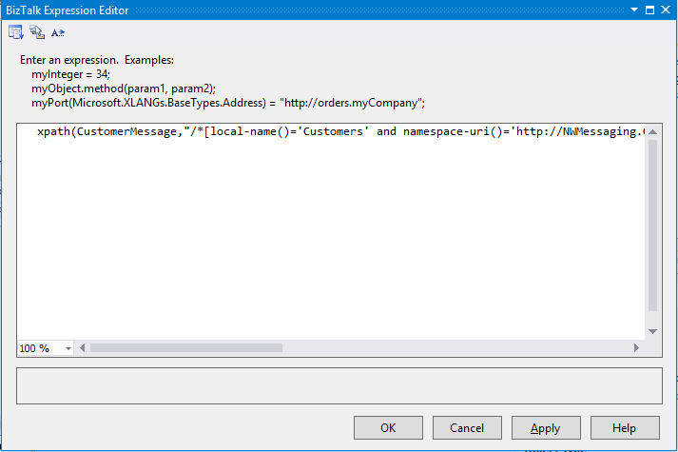
xpath function
xpath function
Can be used in expressions.
Provides read and write access to a message or part of a message.
Write access is only permitted from within an Assign shape.
Not schema aware.
xpath(CustomerMessage,"/*[local-name()='Customers' and namespace-uri()='http://NWMessaging.CustomerOrderFlatFile']/*[local-name()='Customer' and namespace-uri()='']/*[local-name()='ContactNo' and namespace-uri()='']") = "123";

Slide 6
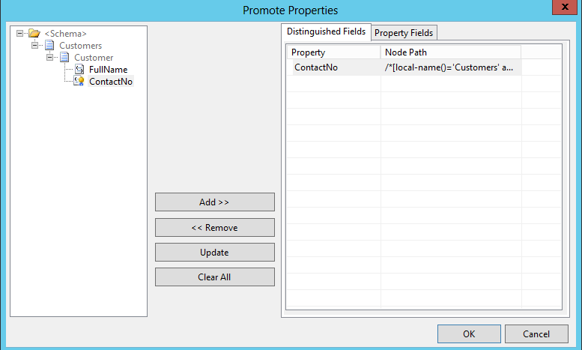
Simplifying Expressions using Distinguished fields
Distinguished fields
Aliases for xpath statements
Lightweight, better performance then promoted fields
Fields are made distinguished through the Promote Properties dialog.
CustomerMessage.Customer.ContactNo = "123";
Caution!
As Distinguished fields are stored in the message together with the namespace, the context of the message can grow much bigger then the message it self.

Slide 7
Calling pipelines from within Orchestrations
Calling Receive pipelines
Can be used to for example split messages
Consumes a single message
Returns a single or many messages
Done from within an atomic scope, typically in an Expression shape
Calling Send pipelines
Can be used to for example aggregate messages
Consumes a single or many messages
Returns a single message
Performed from within an Assign shape

Slide 8
Correlating messages
Automatic correlation
Request-Response ports
Self-correlating ports
Manual correlation / Correlation Sets
Manual correlation involves setting up a correlation type and initializing a correlation set.
A Correlation set is an initialized correlation type with properties and values
Values can come from context as well as data
Notes:
Self-correlating direct bound ports are self referential. This means that a self-correlating direct bound port supplies the information that an orchestration can use to send messages back to its enclosing orchestration. When using the self-correlating direct binding, the orchestration engine generates a correlation token on a message that is particular to the orchestration instance. This provides the capability of getting messages back to a particular orchestration instance without using a correlation set.

Slide 9


Correlating messages
Working with correlation sets
Hint!
Orchestration
Correlation sets are the only way to promote properties in a message published by an orchestration.
Send
Order
- Nummer
Kund
ID
Namn
Typ
...
- Datum
OrderRader
- OrderRad
- ...
.
Initialize correlation set
MsgBox
Correlation Set
OrderID
Instance subscription
Faktura
- Nummer
- OrderNoRef
Kund
ID
Namn
...
- Datum
FakturaRader
FakturaRad
...
.
Receive
Follow correlation set
Notes:
Correlation Types are made up out of properties from propertyschemas.
The picture above is therefore only partially true.

Slide 10
Convoys
What is a convoy?
When multiple single messages must be related to achieve the result
Type of convoys
Sequential
Parallel
Item 1
Item 1
Item 2
Item 3
Item 2
Action
Item 3
Action
Notes:
Sequntial explanation: Cars with blue flags going to a a common location. All receives must be connected to the same Port and receive the same MessageType.
Parallell explanation: A door with many locks that only three keys will unlock. Can be in different order. Can be of different type.

Slide 11

Demonstration: The Aggregator
The Aggregator pattern
Correlating messages
Using a sequential convoy
Calling pipelines from orchestrations
Running the risk of zombies
Notes:
(Slide 11)
BizTalk Server Aggregator sample
<Samples Path>\Pipelines\Aggregator
Open the Aggregator solution. Review the solution. Show the different parts of the orchestration.
Only review the solution. Do not try to deploy and run it.

Slide 12
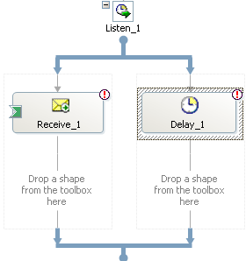
The concept of Zombies
What is a zombie?
Sequential convoy
Receive
A zombie message is a message routed to a running orchestration where the orchestration ended before the message could be delivered.
A zombie service instance is an instance of an orchestration that completed without consuming all of it’s messages.
While < 3 message received
Receive
Add to
Batch
Submit
Batch
Example of situations that can cause zombies
Terminate control messages
Listen shape with a receive and a delay
Convoys

Slide 13
Lesson 1: Transactions
Transactions
Handling exceptions
Performing compensation

Slide 14
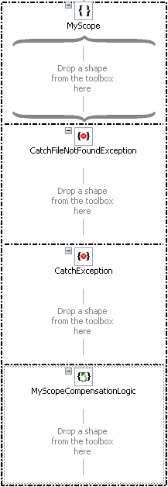
What are Transactions?
Transactions Types
None – No transactional functionality
Long-Running – Saves orchestration state at persistence points.
Atomic – Does not commit state until complete.
The Scope shape
Info!
Transaction type
Contains any number of shapes
Exception handlers
Compensation
Nesting transactional scopes is possible, as long as the parent is Long-Running.

Slide 15
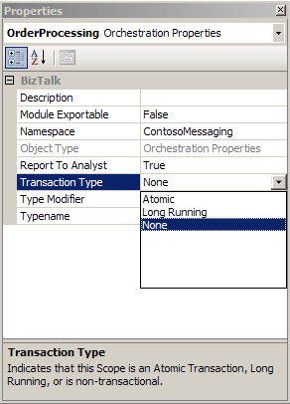
Transacted Orchestrations
Facts
Orchestrations can be equated to a scopes
Orchestrations do not have exception handlers
Orchestrations can have compensation
Orchestration must be transactional to contain a transactional scope
Mark orchestration as transactional through the Transaction Type property

Slide 16
Atomic Transaction Scopes
Facts
Long-Running Orchestration/Scope
Adhere to the ACID principals.
Does not save state (persist) until completed.
Similar to although not equated to DTC transactions.
Receive, Send or Start commits after scope.
Can flow transaction.
Can not have nested scopes, or exception handlers.
Receive
Atomic Scope
Send
Send
ACID
Atomic – Either everything is commits, or nothing.
Consistent – Changes made must be correct.
Isolated – In-flight changes are not visible to outsiders.
Durable – When committed, all data is persisted even in case of subsequent failure.

Slide 17
Long-Running Transaction Scopes
Facts
Long-Running Orchestration
Use when ACID properties are not needed or possible.
Use when the execution time of the logic contained can be long.
Use when external communication is needed.
Uses custom compensation.
Provides no auto rollback in case of error.
Receive
Long-Running Scope
Send
Receive
ACID
Atomic – Either everything is commits, or nothing.
Consistent – Changes made must be correct.
Isolated – In-flight changes are not visible to outsiders.
Durable – When committed, all data is persisted even in case of subsequent failure.

Slide 18
Steps to set up Transactions
1
2
3
Create a scope
Identify potential errors and how to handle them
4
Implement error handlers
5
Determine what needs to be compensated
6
Add compensation logic
Identify the appropriate transaction type

Slide 19
Exceptions
Behavior of exception handlers
Handle exceptions in correct order.
Can contains any shape.
If no exception is thrown or re-thrown orchestration will continue executing.
Unhandled exception will result in a Suspended Orchestration.
Info!
Orchestrations do not have the failed message routing option.
Info!
Behavior of the default (no) exception handler
Atomic scopes cannot have exception handlers.
Call the compensations of nested transactions
Re-throw the exception

Slide 20
Compensation
Behavior of compensation blocks
Used to reverse the effect of a scope.
Can contain any shape.
Compensation does nothing by default.

Slide 21
Demonstration: Compensation
Creating transactions
Handling exceptions
Compensating transactions
Notes:
BizTalk Server Compensation Sample
<Samples Path>\Orchestrations\Compensation
Only show the sample, do not deploy and run it

Slide 22
About transactions in BizTalk Server
Transactional COM+ Component
Transactional orchestration
Receive
Receive Port
Send Port
Transactional adapter
Atomic Scope
Send
Expression
Send
Message Box

Slide 23
About transactions in BizTalk Server
Transactional COM+ component
Transactional orchestration
Receive
Receive Port
Send Port
Transactional adapter
Atomic Scope
Send
Expression
Send
Message Box

Slide 24
Summary
The Expression shape is a powerful tool that allows you to go beyond what the default shapes offer.
Expressions can be simplified using distinguished fields.
Correlations, convoys and zombies are some of the concepts that are involved in more advanced orchestration scenarios.
The Scope shape offers transactional behavior and the handling of exceptions and performing of compensating logic.

Slide 25
Q & A
Applied Orchestration Techniques

Slide 26


Hands-On-Labs
Implementing Transactions
Configure orchestration to use transactions
Create business transactions
Handle exceptions
Configure compensation
Build and deploy, start and test the orchestration

Slide 27

Quiz
What is a convoy?
What are distinguished fields?
What types or transactions can be configured on the Scope shape?

